Slide 1
Search in Games (Chapter 5)
Dr. Shengquan Wang
Most slides are adopted from
Artificial Intelligence: A Modern Approach, 3rd ed. by Stuart Russell (UC Berkeley) and Peter Norvig (Google).
Peter Norvig and Sebastian Thrun for Intro to Artificial Intelligence at Udacity.
Dan Klein and Pieter Abbeel for CS188 Intro to AI at UC Berkeley.

Slide 2

Tic-Tac-Toe
It is a paper-and-pencil game for two players, X and O, who take turns marking the spaces in a 3×3 grid.
The player who succeeds in placing three of their marks in a horizontal, vertical, or diagonal row wins the game.
https://en.wikipedia.org/wiki/Tic-tac-toe

Slide 3
Play Tic-Tac-Toe and Gomoku
Tic-Tac-Toe: https://playtictactoe.org
Gomoku: https://gomokuonline.com

Slide 4
Outline
Introduction

Slide 5
Games
It is a multiagent competitive environment , where the agents’ goals are in conflict.
Each agent’s action is contingent on the other agent’s previous action.

Slide 6

Two-Player Games
Environment
Agent A
A’s move
A’s move
Agent B
B’s move
B’s move

Slide 7
Types of Games
 | Deterministic | Stochastic
Fully Observable | chess checkers go | backgammon monopoly
Partially Observable | blind tic-tac-toe | bridge poker scrabble
Our initial focus:
Deterministic
Fully observable
Turn-taking
Two-player
Zero-Sum

Slide 8
How to Win?
It is an adversarial search problem.
The search tree is called game tree.

Slide 9
Outline
Introduction
Game Tree

Slide 10
Game Tree
A search tree
The nodes are game states.
The edges are moves.

Slide 11
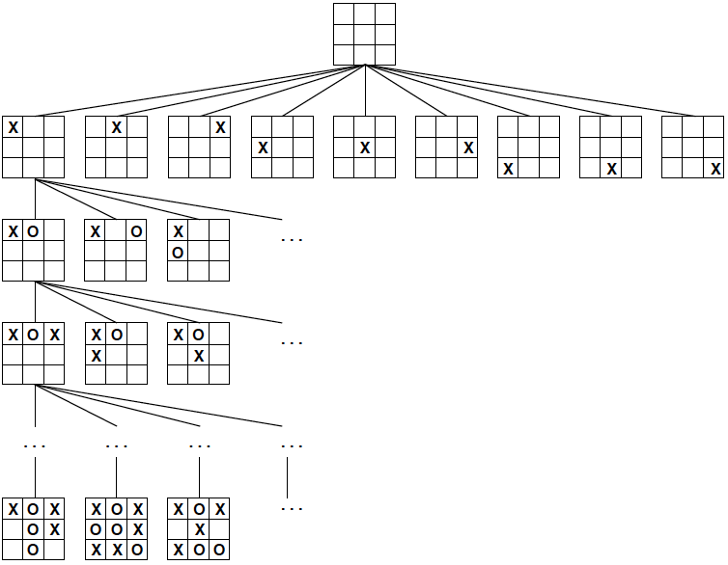
A Partial Game Tree for Tic-Tac-Toe
fewer than 9! = 362,880 terminal nodes

Slide 12
Quiz: Strategy for Winning a Game
Uncertainties: we don’t know the future moves of our opponent.

Slide 13
Optimal Strategy
We need to consider the worst-case scenario: our opponent always picks the best move.
We don’t take a chance.

Slide 14
Outline
Introduction
Game Tree
Optimal Strategy: Minimax

Slide 15
Optimal Strategy: Minimax
Minimax: for each move, minimize the maximum gain among all our opponent’s potential moves.

Slide 16
Optimal Strategy: Two Questions
How to define gain values for two sides?
How to obtain gain values for non-terminal nodes?

Slide 17
How to define gain values for two sides?
We can define gain as utility from the perspective of one side, e.g., from the perspective of X in Tic-Tac-Toe
If X wins, X’s utility is +1 and O’s utility is -1
If X loses, X’s utility is -1 and O’s utility is +1
X aims to maximize its utility: MAX(X) O aims to minimize its utility: MIN(O)

Slide 18
How to obtain gain values for non-terminal nodes?
Perform recursion upon the game tree until the terminal nodes.
We call the gain value at each node as Minimax value.

Slide 19
Minimax Value for a Node n
If n is a Terminal node:
Utility(n)
If n is a Max node:
MaxValue(n) -- Max of n’s successors’ values
If n is a Min node:
MinValue(n) -- Min of n’s successors’ values

Slide 20
Minimax Algorithm
It uses DFS with a simple recursive computation of the minimax values of each successor state.
It proceeds all the way down to the leaves of the tree, and then the minimax values are backed up through the tree.
It keeps track of the minimax decisions from the current state through the recursion.

Slide 21
Example: Tic-Tac-Toe
X
O | O | X
 | X
O | X
0
O
O | O | X
 | X | X
O | X
O | O | X
 | X
O | X | X
O | O | X
X | X
O | X
-1
-1
0
X
O | O | X
O | X | X
O | X
O | O | X
 | X | X
O | X | O
O | O | X
O | X
O | X | X
O | O | X
 | X | O
O | X | X
O | O | X
X | X | O
O | X
O | O | X
X | X
O | X | O
-1
1
-1
0
0
1
O | O | X
X | X | X
O | X | O
O | O | X
X | X | O
O | X | X
O | O | X
X | X | O
O | X | X
O | O | X
X | X | X
O | X | O
1
0
0
1
Right child is added to frontier first;
Left child returns values and/or is expanded first.

Slide 22
Quiz: Tic-Tac-Toe
X
X | X | O
O | O
X
?
O
X

Slide 23
Quiz: Solution
X
X | X | O
O | O
X
0
O
X | X | O
O | O | X
X
X | X | O
O | O
X | X
X | X | O
O | O
X |  | X
0
-1
-1
X
X | X | O
O | O | X
X | O
X | X | O
O | O | X
X |  | O
X | X | O
O | O | O
X | X
X | X | O
O | O
X | X | O
X | X | O
O | O | O
X |  | X
X | X | O
O | O
X | O | X
0
0
-1
0
-1
0
X | X | O
O | O | X
X | O | X
X | X | O
O | O | X
X | X | O
X | X | O
O | O | X
X | X | O
X | X | O
O | O | X
X | O | X
0
0
0
0

Slide 24
Example: 2-ply Game
Max
2
1 move with 2 half-moves (2 plies)
Min
-8
-4
2
Max
3
12
-8
2
-4
6
14
5
2
Right child is added to frontier first;
Left child returns values and/or is expanded first.

Slide 25
Quiz
Max
?
Min
?
?
?
Max
-9
-7
2
6
-3
-8
4
7
5
Right child is added to frontier first;
Left child returns values and/or is expanded first.

Slide 26
Quiz: Solution
Max
4
Min
-9
-8
4
Max
-9
-7
2
6
-3
-8
4
7
5
Right child is added to frontier first;
Left child returns values and/or is expanded first.

Slide 27
Utility Vector
For more than two players, we use utility vector instead of single minimax value.
We can convert minimax value into utility vector.

Slide 28
Example: Utility Vector (A,B) for Two Players
A
(4,-4)
B
(-9,9)
(-8,8)
(4,-4)
(-9,9)
(-7,7)
(2,-2)
(6,-6)
(-3,3)
(-8,8)
(4,-4)
(7,-7)
(5,-5)

Slide 29
Example: Utility Vector (A,B,C) for Three Players
A
B
C
(1, 2, 6)
(1, 2, 6)
(1, 5, 2)
(1, 2, 6)
(6, 1, 2)
(1, 5, 2)
(5, 4, 5)
(1, 2, 6)
(4, 2, 3)
(6, 1, 2)
(7, 4, 1)
(5, 1, 1)
(1, 5, 2)
(7, 7, 1)
(5, 4, 5)
Every player aims to maximize its own utility.
For tie-break, it can choose randomly or with an extra criteria.

Slide 30
Minimax Properties
Complete | Yes, if tree is finite (chess has specific rules for this)
Time | O(b^{m}) For chess, b=35, m=100 for “reasonable” games. exact solution completely infeasible. But do we need to explore every path?
Space | O(bm), DFS
Optimal | Yes, against an optimal opponent.

Slide 31
Issue: Scale
Chess:
Average branching factor of about 35.
Games often go to 50 moves by each player.
Game tree for chess:
About 35¹⁰⁰ or 10¹⁵⁴ nodes.
Too expensive to use.

Slide 32
Quiz
How to reduce the time complexity O(b^{m})?
Cutting branch
Reducing depth

Slide 33
Outline
Introduction
Game Tree
Optimal Strategy: Minimax
Pruning
Cutting branch

Slide 34
Example: 2-ply Game
3
Max
≥3
X
Min
3
≤2
2
X
X
3
12
8
2
14
5
2
Right child is added to frontier first;
Left child returns values and/or is expanded first.

Slide 35
α-β Pruning
Define α as the best value (to Max) found so far off the current path.
If v is smaller than α, Max will avoid it => prune that branch.
Max
Min
α
X
v
X

Slide 36
α-β Pruning (cont’d)
Similarly, define β as the best value (to Min) found so far off the current path.
If w is greater than β, Min will avoid it => prune that branch.
Min
β
Max
X
w
X

Slide 37
Quiz: Pruning
Max
Min
3
12
8
2
7
9
1
5
14
Right child is added to frontier first;
Left child returns values and/or is expanded first.

Slide 38
Quiz: Solution
Max
3
X
X
Min
3
≤2
≤1
X
X
X
X
3
12
8
2
7
9
1
5
14
Right child is added to frontier first;
Left child returns values and/or is expanded first.

Slide 39
Quiz: Pruning
Max
Min
4
5
6
3
8
3
4
7
9
Right child is added to frontier first;
Left child returns values and/or is expanded first.

Slide 40
Quiz: Solution
4
Max
X
X
≤3
4
≤4
Min
4
X
X
4
5
6
3
8
X
X
3
4
7
9
Right child is added to frontier first;
Left child returns values and/or is expanded first.

Slide 41
Properties of α-β Pruning
Pruning does not affect final result.
Good move ordering improves effectiveness of pruning.
With “perfect ordering,”
Time complexity = O(b^{m/2})
Doubles solvable depth
Unfortunately, 35^{100/2} for chess is still impossible!

Slide 42
Outline
Introduction
Game Tree
Optimal Strategy: Minimax
Pruning
Cutting branch
Reducing depth

Slide 43
Cutoff with Evaluation Function
Use Cutoff-Test instead of Terminal-Test
e.g., depth limit.
Use Eval instead of Utility
i.e., evaluation function that estimates desirability of position.

Slide 44
Eval: Evaluation Function
The evaluation function should be strongly correlated with the actual chances of winning.
The computation must not take too long.
Most evaluation functions work by calculating various features of the state.

Slide 45
Features
The features define various categories of states.
E.g., in chess, features: the number of white pawns, black pawns, white queens, black queens, and so on.
Evaluation function is a function of features.
E.g., in chess: Linear weighted sum of features.
Eval(s) = w₁f₁(s) + w₂f₂(s) + …+ w_{n}f_{n}(s) w₁ = 9 f₁(s) = (number of white queens) - (number of black queens)

Slide 46
Example
Suppose our experience suggests that of the states encountered in the two-pawns vs. one-pawn category
72% lead to a win (utility=+1)
20% to a loss (0)
8% to a draw (1/2)
Then a reasonable evaluation for states in the category is the expected value:
(0.72 × (+1)) + (0.20 × 0) + (0.08 × (1/2)) = 0.76.

Slide 47
Cutoff-Test: a Simple Approach
Set a fixed depth limit so that it returns true for all depth greater than some fixed depth d.
The depth d is chosen so that a move is selected within the allocated time.
It can lead to errors due to the approximation.

Slide 48
Cutoff-Test: Quiescence Search Approach
The evaluation function should be applied only to positions that are unlikely to exhibit wild swings in value in the near future.
In chess, for example, positions in which favorable captures can be made are not quiescent for an evaluation function that just counts material.
Quiescence search: Non-quiescent positions can be expanded further until quiescent positions are reached.

Slide 49
Forward Pruning
Some moves at a given node are pruned immediately without further consideration.
Clearly, most humans playing chess consider only a few moves from each position (at least consciously).
Beam search:
On each ply, consider only a “beam” of the n best moves (according to the evaluation function) rather than considering all possible moves.
PprobCut:
It uses statistics gained from prior experience to lessen the chance that the best move will be pruned.

Slide 50
Lookup
Many game-playing programs use table lookup rather than search for the opening and ending of games.
For the openings, the computer is mostly relying on the expertise of humans.
Usually after ten moves we end up in a rarely seen position, and the program must switch from table lookup to search.
Near the end of the game there are again fewer possible positions, and thus more chance to do lookup.

Slide 51
Outline
Introduction
Game Tree
Optimal Strategy: Minimax
Pruning
Cutting branch
Reducing depth
Monte Carlo tree search

Slide 52
Monte Carlo Tree Search
It doesn’t use heuristic evaluation function.
Instead, the value of a state is estimated as the average utility over a number of simulations of complete games starting from the state.

Slide 53
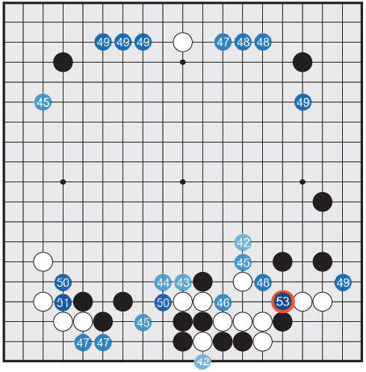
AlphaGo
Black to play:
Percentage of winning if playing at some potential spots.
D Silver et al. Nature 529, 484–489 (2016) doi:10.1038/nature16961

Slide 54
Outline
Introduction
Game Tree
Optimal Strategy: Minimax
Pruning
Stochastic Games

Slide 55
Stochastic Games
Many games mirror this unpredictability by including a random element, such as the throwing of dice.

Slide 56
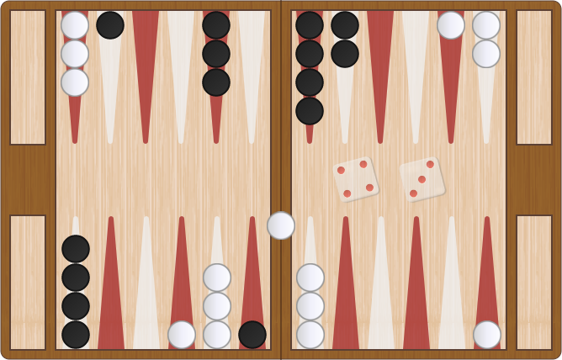
Backgammon
https://cardgames.io/backgammon

Slide 57
Play Backgammon
https://cardgames.io/backgammon

Slide 58
Game Tree with Chance Node
Chance
1/36
{1,1}
1/36
{6,6}
Expected Value
1/18
{1,2}
Max
…
Max Value
1/36
{1,1}
Chance
Expected Value
…
1/36
{6,6}
1/18
{1,2}
Min
…
Min Value

Slide 59
Backgammon In Practice
Complexity:
Number of rolls n: 21 possible rolls with 2 dice.
Branching factor b: about 20 legal moves.
Even for a small depth m=4, the complexity is O((bn)^{m}) = O((21*20)⁴) ≈ 3.1*10¹⁰.
TDGammon: world-champion level
Use depth-2 search + very good Eval.

Slide 60
Game Tree for Coin Flipping
?
H: 50%
T: 50%
H
T
?
?
?
?
?
?
H
T
H
T
H
T
H
T
?
7
8
?
0
6
?
4
1
3
2
4
0
10

Slide 61
Solution
4
H: 50%
T: 50%
H
T
5
3
4
5
3
2
H
T
H
T
H
T
H
T
1
7
8
2
0
6
0
4
1
3
2
4
0
10

Slide 62
Quiz
?
H: 50%
T: 50%
H
T
?
?
?
?
?
?
H
T
H
T
H
T
H
T
?
4
2
?
8
0
?
12
6
7
4
5
0
6

Slide 63
Quiz: Solution
5.5
H: 50%
T: 50%
H
T
5
6
5
3
4
6
H
T
H
T
H
T
H
T
6
4
2
4
8
0
0
12
6
7
4
5
0
6

Slide 64
Outline
Introduction
Game Tree
Optimal Strategy: Minimax
Pruning
Stochastic Games
Partially Observable Games

Slide 65
Partially Observability
In the “fog of war,” the existence and disposition of enemy units is often unknown until revealed by direct contact.
As a result, warfare includes the use of scouts and spies to gather information and the use of concealment and bluff to confuse the enemy.
Partially observable games share these characteristics and are thus qualitatively different from the games described before.

Slide 66
Card Games
In card games, opponent's initial cards are unknown.
We can calculate a probability for each possible deal.
Just like having one big dice roll.
Idea:
Compute the minimax value of each action in each deal and then choose the action with highest expected value over all deals.

Slide 67
Play Texas Holdem
https://www.table-games-online.com/ultimate-texas-holdem

